Slide 1
Ch 3. Interdependence and the Gains from Trade
“Trade can make everyone better off” – how countries can gain from trade??
Example: Two countries, two goods model, Narnia & Neverland, Computers & Wheat, One resource(labor hours)
1. PPF in Narnia (same as previous chapter)
Suppose Narnia uses half its labor to produce each of the two goods. Then it will produce and consume 250 computers and 2,500 tons of wheat.
2. Neverland’s PPF
Neverland has 30,000 hours of labor available for production, per month. Producing one computer requires 125 hours of labor. Producing one ton of wheat requires 25 hours of labor.
How many computers and wheat they can produce??
Suppose Neverland uses half its labor to produce each good. Then it will produce and consume 120(=15,000/125) computers and 600(=15,000/25) tons of wheat.
3. Comparison between consumption <Without trade> vs. <with trade>
4. Preparation for trade
Suppose Narnia produces 3400 tons of wheat. Also suppose Neverland produces 240 computers.
5. Consumption under trade
Suppose Narnia exports 700 tons of wheat to Neverland, and imports 110 computers from Neverland. (Neverland imports 700 tons wheat and exports 110 computers.)

Slide 2
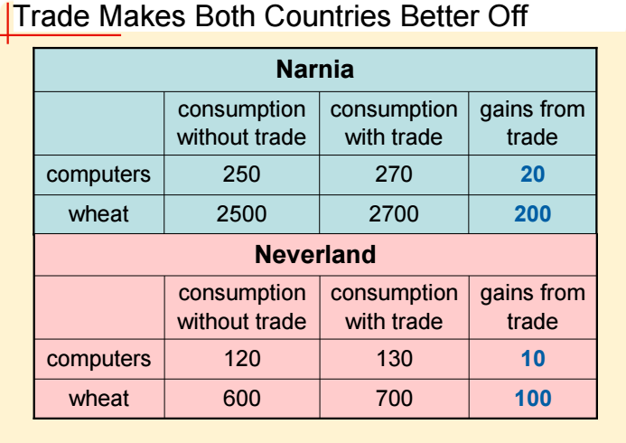
Absolute advantage :
The ability to produce a good using fewer inputs than another producer.
Measures the cost of a good in terms of the inputs required to produce it
Comparative advantage:
The ability to produce a good at a lower opportunity cost than another producer
Principle of comparative advantage : Specialization!!
Gains from trade arise from comparative advantage.
When each country specializes in the good(s) in which it has a comparative advantage
All countries can gain from trade

